Slide 1
Realistic Composite Image Generation Using GANs Shivangi Aneja, Soham Mazumder
Team 18: Shivangi and Soham
1

Slide 2
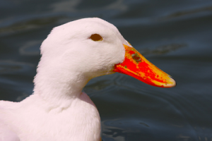
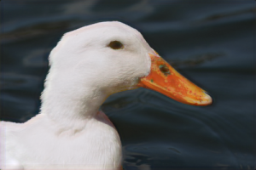
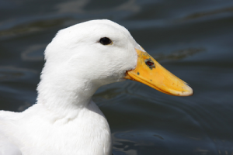
Recap
Goal : Produce realistic composite images
Input: Composite Image
Output: Realistic Image
Ground Truth
Team 18: Shivangi and Soham
2

Slide 3
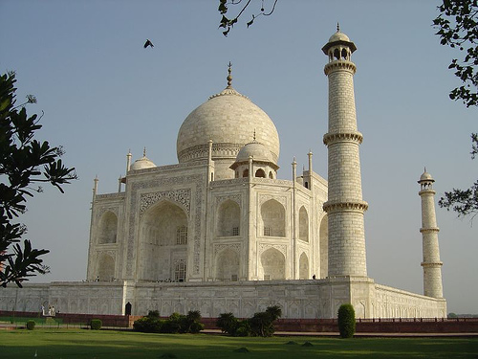

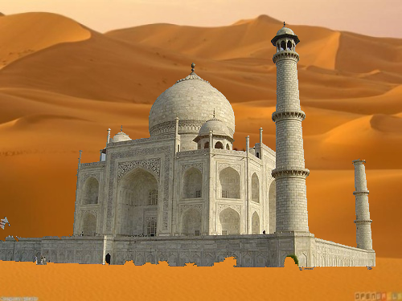
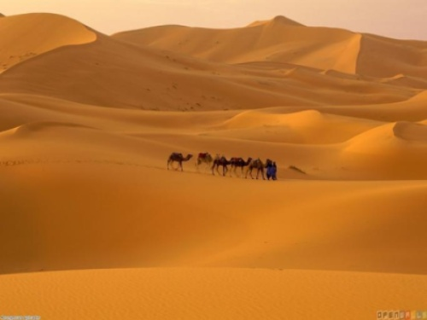
Old Data Generation Pipeline
Input Image
Composite Image
Background
Team 18: Shivangi and Soham
3

Slide 4

Old Data Generation Pipeline
Ground Truth Generation
Pre-trained Deep Image Harmonization Model (Caffe)
Composite Image
Laplacian Pyramid
Ground Truth
Team 18: Shivangi and Soham
4

Slide 5
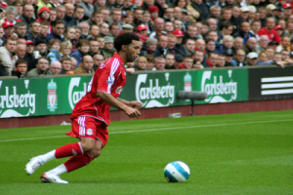
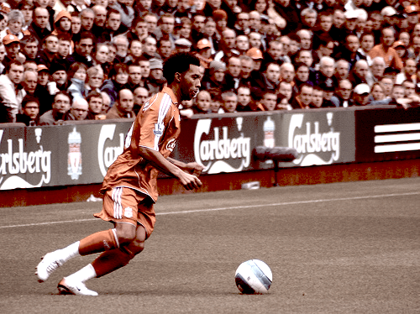
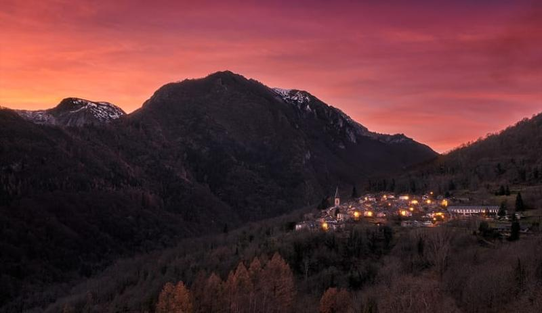
New Data Generation Pipeline
Input Image
Using ACACTS [3]
Stylized Image
Reference Image
Team 18: Shivangi and Soham
5

Slide 6
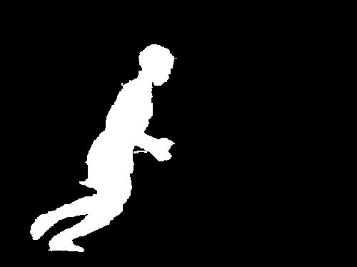
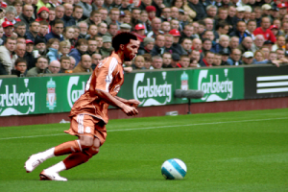
New Data Generation Pipeline
Stylized Image
Composite Image
Ground Truth
Team 18: Shivangi and Soham
6

Slide 7
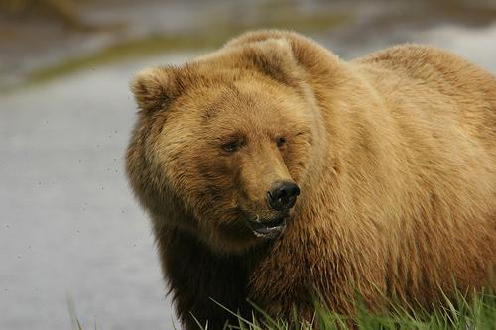

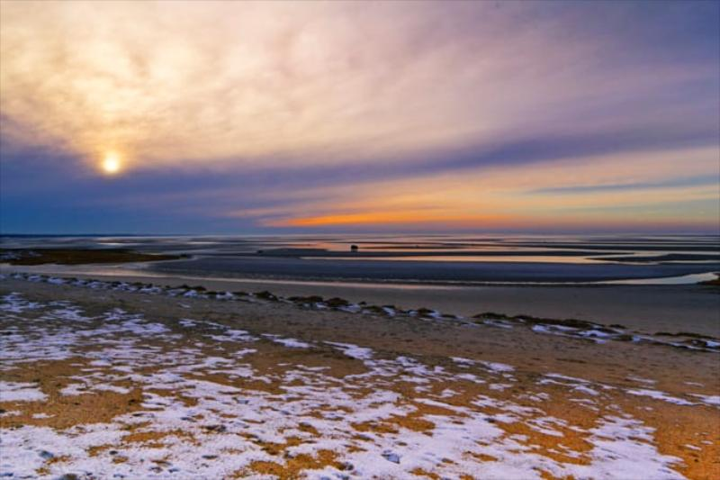

Dataset
CMU-Cornell iCoseg dataset [2]
Co-segmentation of 38 groups (643 images)
Style Images [3]
Training : 3739 Images
Validation : 374 Images
Image Size : 300*200 px
Team 18: Shivangi and Soham
7

Slide 8
Generator Architecture
Conv64
Conv128
Conv256
Conv256
Conv256
Conv256
Conv128
Conv64
Input : Composite Image
Generator Architecture
Output : Generated Image
Team 18: Shivangi and Soham
8

Slide 9
Discriminator Architecture
Score [0,1]
Conv64
Maxpool
Resnet Block
(Conv64 )
Resnet Block
(Conv64 )
FC
Discriminator Architecture
Input : Generated Images, Ground Truth Images
Team 18: Shivangi and Soham
9

Slide 10
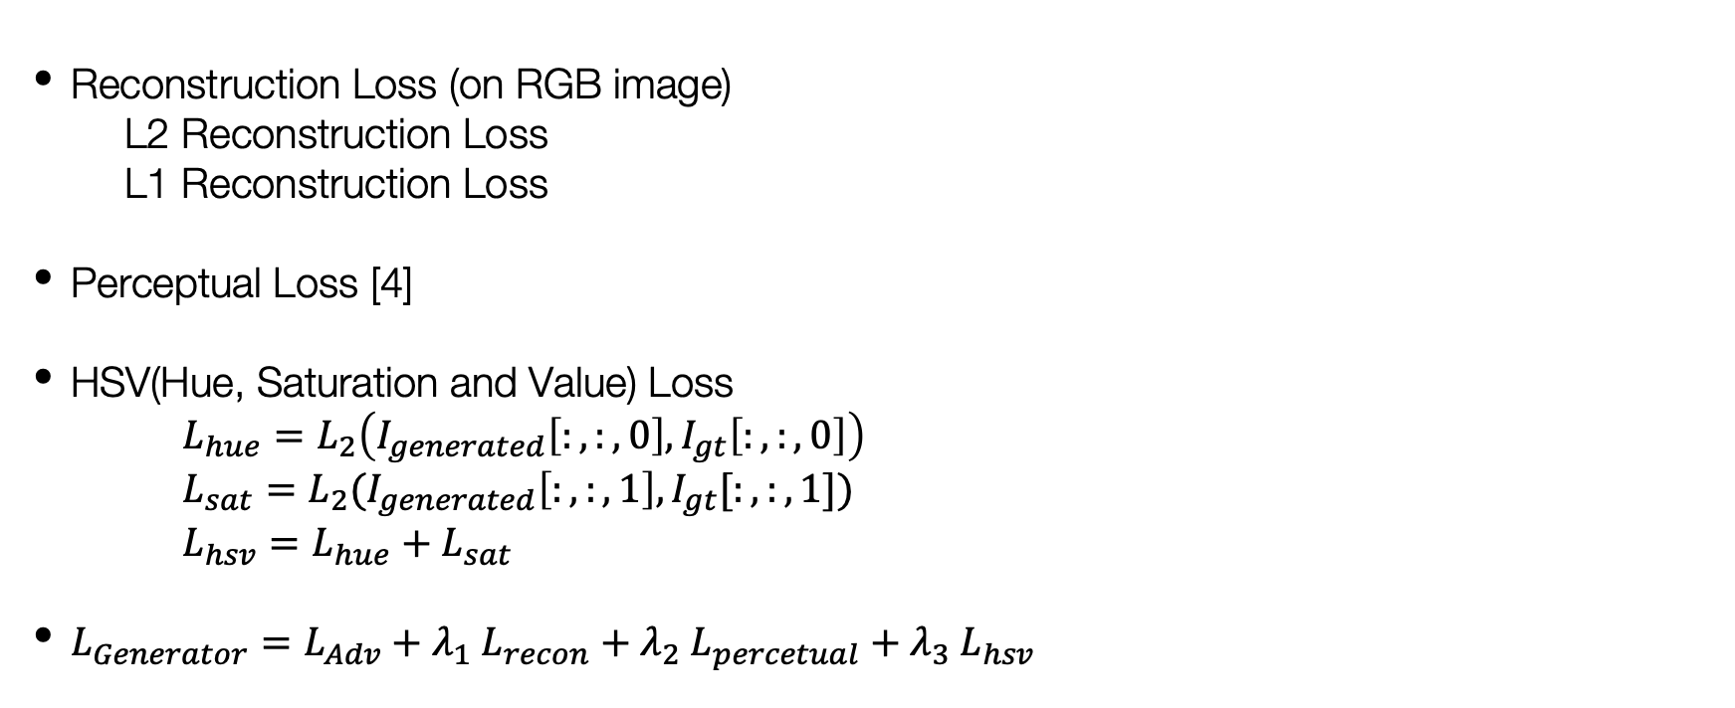
Loss Functions
Reconstruction Loss (on RGB image)
L2 Reconstruction Loss
L1 Reconstruction Loss
Perceptual Loss [4]
HSV(Hue, Saturation and Value) Loss
$L_{hue}=L_{2}\left(I_{generated}\left[:,:,0\right], I_{gt}\left[:,:,0\right]\right)$
$L_{sat}=L_{2}(I_{generated}\left[:,:,1\right],I_{gt}[:,:,1])$
$L_{hsv}=L_{hue}+L_{sat}$
$L_{Generator}=L_{Adv}+λ_{1} L_{recon}+λ_{2} L_{percetual}+λ_{3} L_{hsv}$
Team 18: Shivangi and Soham
10

Slide 11
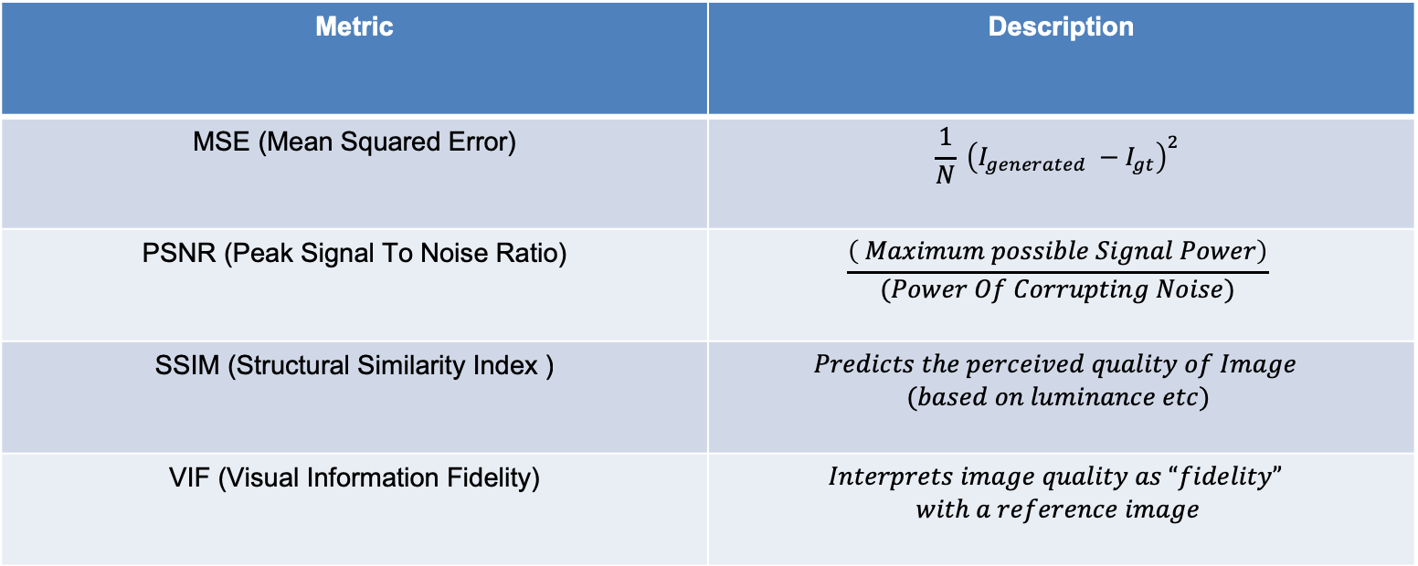
Evaluation Metrics
Metric | Description
MSE (Mean Squared Error) | $$\frac{1}{N} {\left(I_{generated} −I_{gt}\right)}^{2}$$
PSNR (Peak Signal To Noise Ratio) | $$\frac{\left( Maximum possible Signal Power\right)}{(Power Of Corrupting Noise)}$$
SSIM (Structural Similarity Index ) | $$Predicts the perceived quality of Image$$ $$(based on luminance etc)$$
VIF (Visual Information Fidelity) | $$Interprets image quality as “fidelity”$$ $$with a reference image$$
Team 18: Shivangi and Soham
11

Slide 12
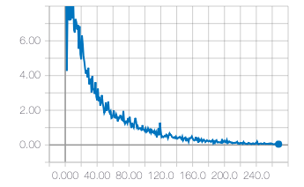
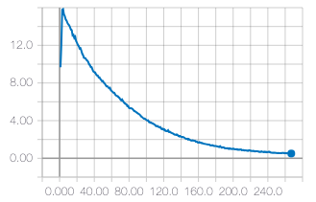
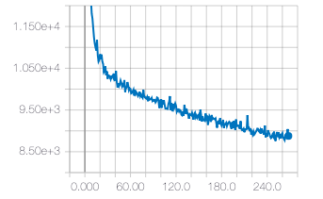
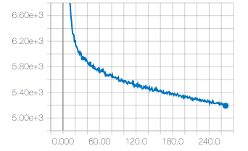
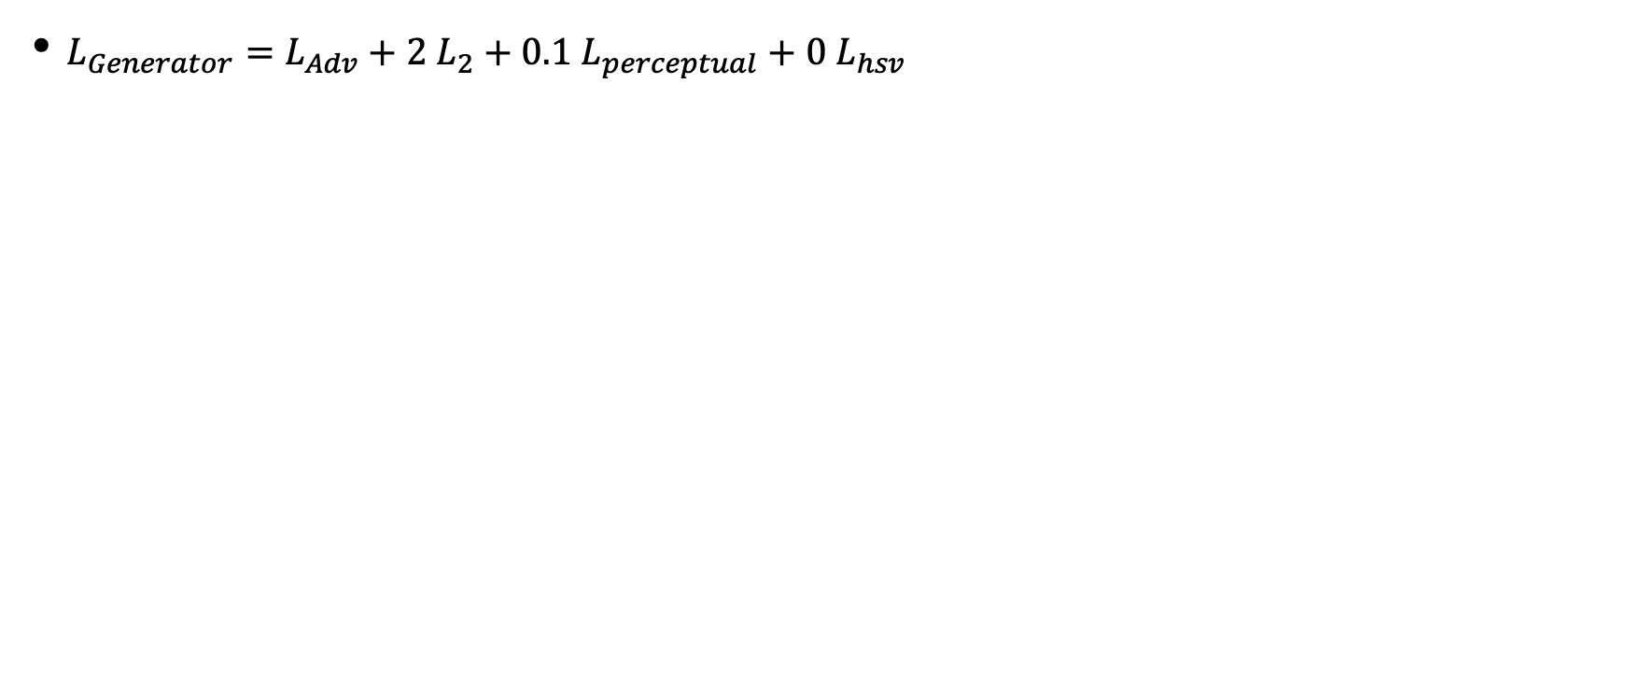
Results: Configuration A
$L_{Generator}=L_{Adv}+2 L_{2}+0.1 L_{perceptual}+0 L_{hsv}$
Hyperparameters
D lr : 1e-7
G lr : 1e-5
Optimizer : Adam
Batch Size : 5
Training Discriminator Loss
Validation Discriminator Loss
Training Generator Loss
Validation Generator Loss
12
Team 18: Shivangi and Soham

Slide 13
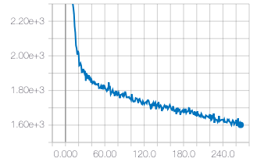
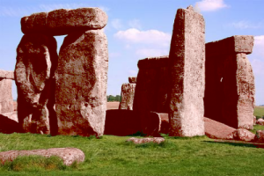
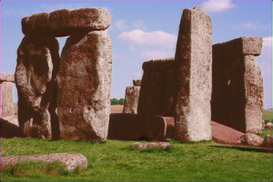
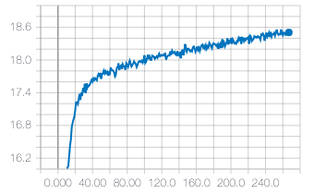
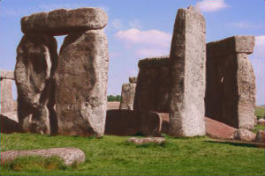
Results: Configuration A
Mean Squared Error
Composite Image
Generated Image
Not very good results with high
weightage to L2 loss
PSNR
Ground Truth
13
Team 18: Shivangi and Soham

Slide 14
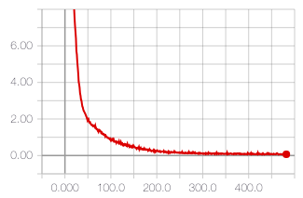
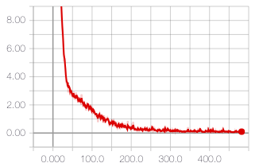
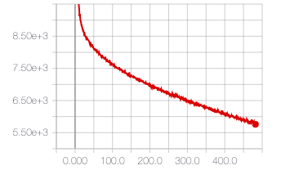
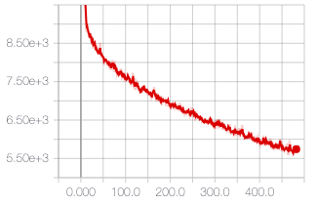
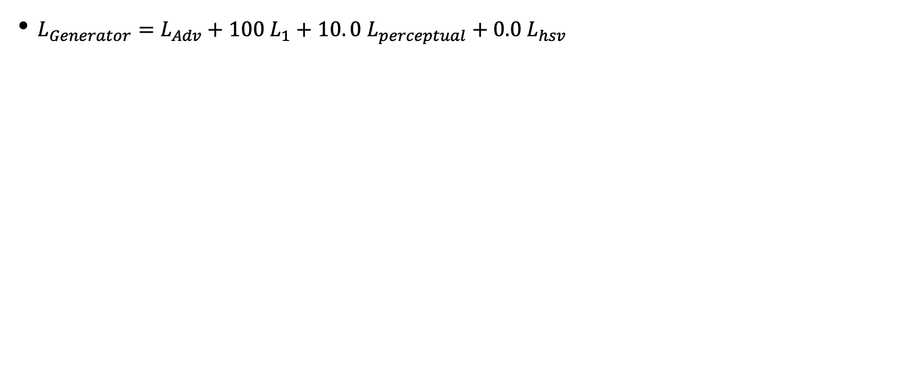
Results: Configuration B
$L_{Generator}=L_{Adv}+100 L_{1}+10. 0 L_{perceptual}+0.0 L_{hsv}$
Hyperparameters
D lr : 1e-7
G lr : 1e-5
Optimizer : Adam
Batch Size : 5
Training Discriminator Loss
Validation Discriminator Loss
Training Generator Loss
Validation Generator Loss
14
Team 18: Shivangi and Soham

Slide 15
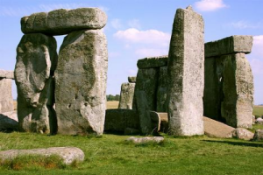
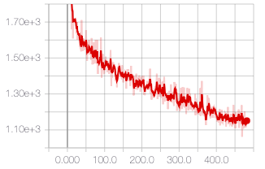
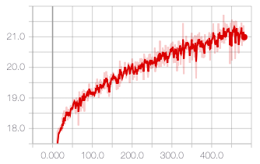
Results: Configuration B
Composite Image
Ground Truth Image
Mean Squared Error
Generated
PSNR
Team 18: Shivangi and Soham
15

Slide 16
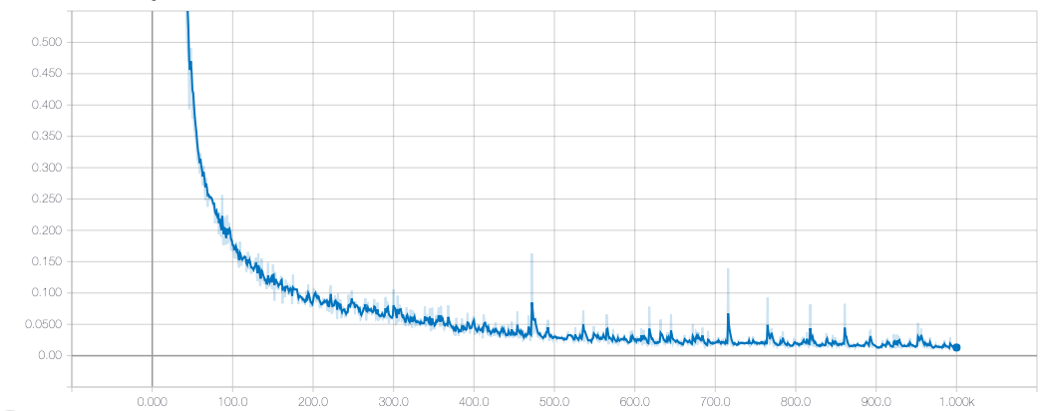
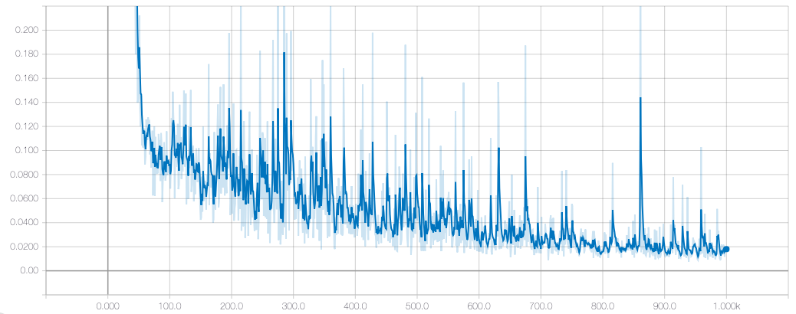
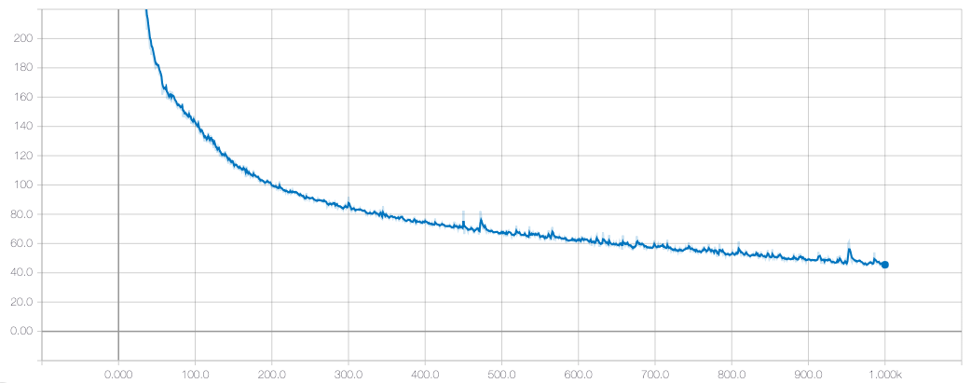
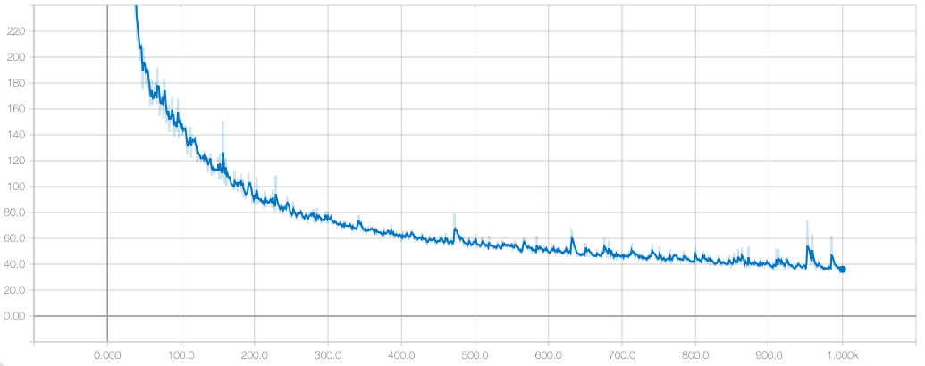
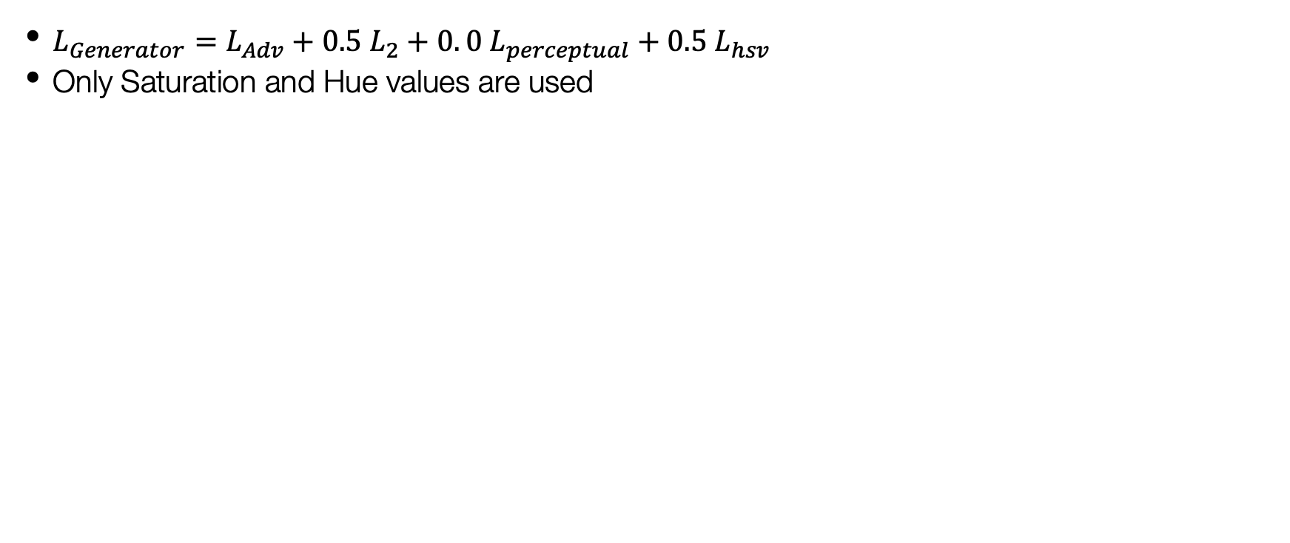
Results: Configuration C
$L_{Generator}=L_{Adv}+0.5 L_{2}+0. 0 L_{perceptual}+0.5 L_{hsv}$
Only Saturation and Hue values are used
Hyperparameters
D lr : 1e-7
G lr : 1e-5
Optimizer : Adam
Batch Size : 5
Training Discriminator Loss
Validation Discriminator Loss
Validation Generator Loss
16
Training Generator Loss
Team 18: Shivangi and Soham

Slide 17
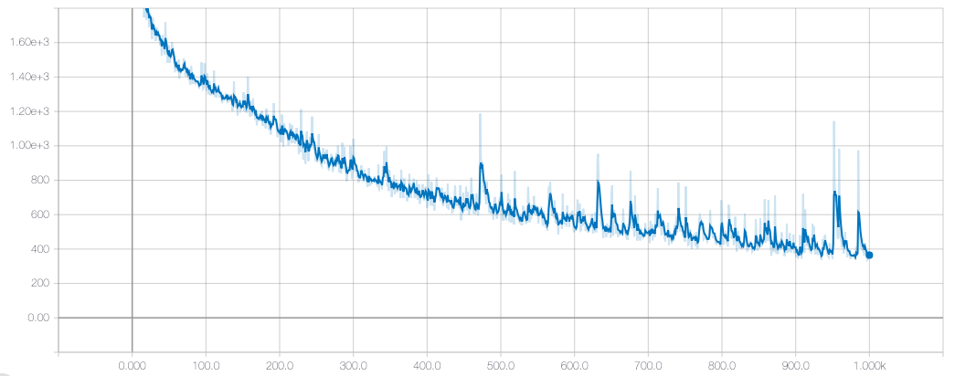
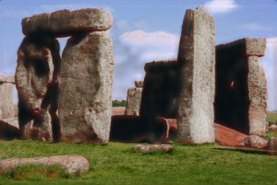
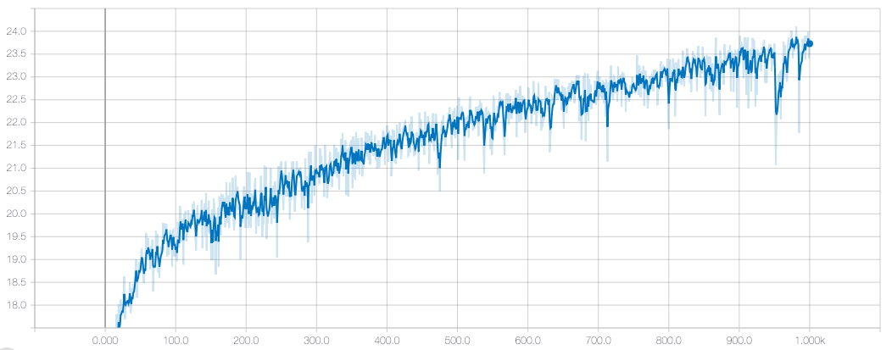
Results: Configuration C
Composite Image
Ground Truth Image
Mean Squared Error
PSNR
Generated
Team 18: Shivangi and Soham
17
Relatively better results

Slide 18
Results: Comparison
S. No. | Configuration | MSE | PSNR | SSIM | VIF
1 | A | 1956.96 | 17.67 | 0.87 | 0.549
2 | B | 1542.31 | 19.02 | 0.89 | 0.578
3 | C | 1043.65 | 20.94 | 0.88 | 0.605
A : $L_{Generator}=L_{Adv}+2 L_{2}+0.1 L_{perceptual}+0 L_{hsv}$
B : $L_{Generator}=L_{Adv}+100 L_{1}+10. 0 L_{perceptual}+0.0 L_{hsv}$
C: $L_{Generator}=L_{Adv}+0.5 L_{2}+0. 0 L_{perceptual}+0.5 L_{hsv}$
Team 18: Shivangi and Soham
18

Slide 19
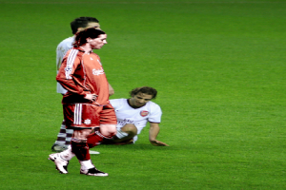
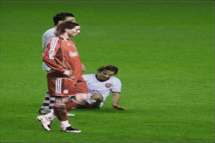
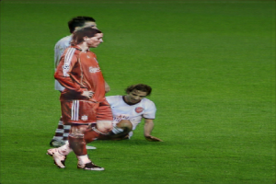
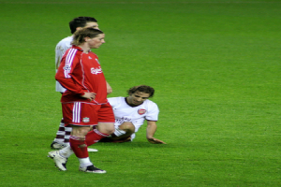
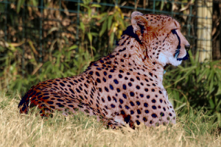
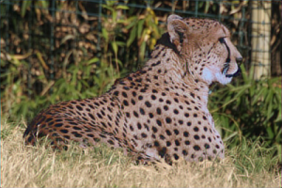
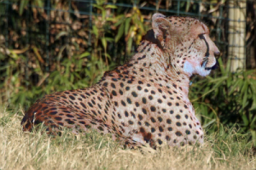
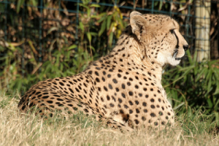
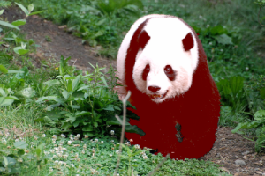



Results: Comparison
Composite Image
Configuration B
Configuration C
Ground Truth
Team 18: Shivangi and Soham
19

Slide 20






Failure Cases
Composite Image
Prediction
Ground Truth
Team 18: Shivangi and Soham
20

Slide 21

Project Plan
Presentation 2
Final
Presentation
Presentation 1
Google Cloud Setup
Dataloaders and Network Pipeline coded
Synthetic Ground Truth Image Generation using Pre-trained network
Overfitting on smaller dataset
Train on bigger images
Try out bigger architectures
Results with skip links
Results with additional loss functions
Final Dataset preparation
Metric Evaluation
Fine-tune results on final architecture
Hyper-parameter search
Try out PatchGAN (in progress)
Team 18: Shivangi and Soham
21

Slide 22
Challenges
Only adversarial and reconstruction loss were not enough for the purpose of matching colors.
Discriminator became much powerful in comparison to Generator
The D-loss was relatively very low in comparison to G-loss
Team 18: Shivangi and Soham
22

Slide 23
Conclusions
Hue and Saturation are important to consider in generating realistic images.
Bad Results : Using only any „ONE“ of the above losses.
Unable to learn difficult filters. Needs more fine-tuning.
Adding skip links helped learn diverse filters
Resnet blocks made discriminator more powerful and reduced training time
Team 18: Shivangi and Soham
23

Slide 24
Thank You
Team 18: Shivangi and Soham
24

Slide 25
References
[1] http://places2.csail.mit.edu/
[2] Dhruv Batra, Adarsh Kowdle, Devi Parikh, Jeibo Luo and Tsuhan Chen. "iCoseg: Interactive Co-segmentation with Intelligent Scribble Guidance", Computer Vision and Pattern Recognition, 2010
[3] J.-Y. Lee, K. Sunkavalli, Z. Lin, X. Shen, and I. S. Kweon. “Automatic content-aware color and tone stylization“ .arXivpreprint arXiv:1511.03748, 2015
[4] L. F.-F. Justin Johnson, Alexandre Alahi. Perceptual lossesfor real-time style transfer and super-resolution. 2016
Team 18: Shivangi and Soham
25

